Slide 1
Network Risks

Slide 2
Security Risks (1 of 2)
Hacker originally meant someone who masters the inner workings of computer hardware and software in an effort to better understand them
Today, hacker is used to describe an individual who gains unauthorised access to systems

Slide 3
Security Risks (1 of 2)
Hackers are categorised according to their intent and the prior approval of the organisations whose networks they’re hacking
White hat hacker is an IT security expert hired by organisations to identify security vulnerabilities
They are sometimes called an ethical hacker
Black hat hackers are groups or individuals that cause damage, steal data, or compromise privacy
Gray hat hackers abide by a code of ethics all their own
They might engage in illegal activity, but their intent is to educate and assist

Slide 4
Security Risks (2 of 2)
Vulnerability is a weakness of a system, process, or architecture
Exploit is the act of taking advantage of a vulnerability
Zero-day exploit or zero-day attack is one that takes advantage of a software vulnerability
The vulnerability is exploited before the software developer is aware of the vulnerability
Keep in mind that malicious and determined intruders may use one technique
Which then allows them to use a second technique, which then supports a third technique, and so on

Slide 5
People Risks (1 of 2)
More than half of all security breaches are caused by human errors, ignorance, and omissions
Social engineering is a strategy to gain a user’s password
Common types of social engineering:
Phishing
Baiting
Quid pro quo
Tailgating
Piggybacking
Shoulder surfing

Slide 6
People Risks (2 of 2)
The most important defense against social engineering is employee training
An insider threat is someone trusted by an organisation who may have or develop malicious intent
Measures to reduce insider threat risks:
Perform background checks for new hires
Enforce the principle of least privilege, meaning employees are given minimal access to do their job
Design checks and balances on employee behavior
Deploy a DLP (data loss prevention) solution that identifies sensitive data and prevents it from being copied or transmitted off the network

Slide 7
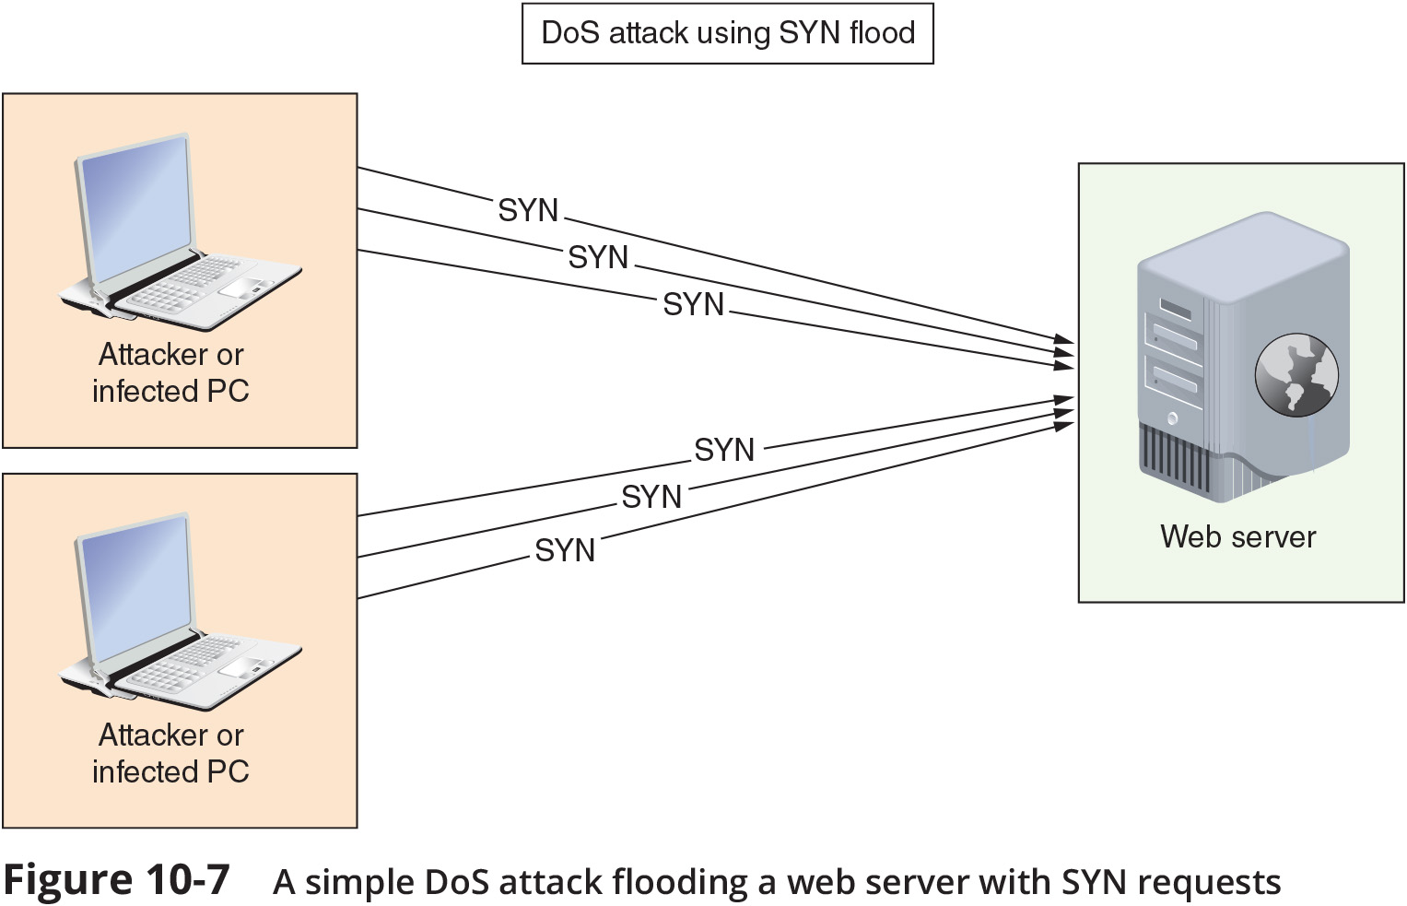
Technology Risks (1 of 4)
A DoS (denial-of-service) attack occurs when an intruder issues a flood of broadcast ping messages preventing legitimate users from accessing normal network resources
There are several DoS subtypes:
Distributed DoS (DDoS) attack – are orchestrated through several sources, called zombies
DRDoS (distributed reflection DoS) attack – a DDoS attack is a type of DDoS attack that is bounced off uninfected computers, called reflectors, before being directed at target

Slide 8
Technology Risks (1 of 4)
Amplified DRDoS attack – can be amplified when conducted using small, simple requests that trigger very large responses from the target
PDoS (permanent DoS) attack – A PDoS attack damages a device’s firmware beyond repair
Friendly DoS attack – an unintentional DoS attack has no malicious intent

Slide 9
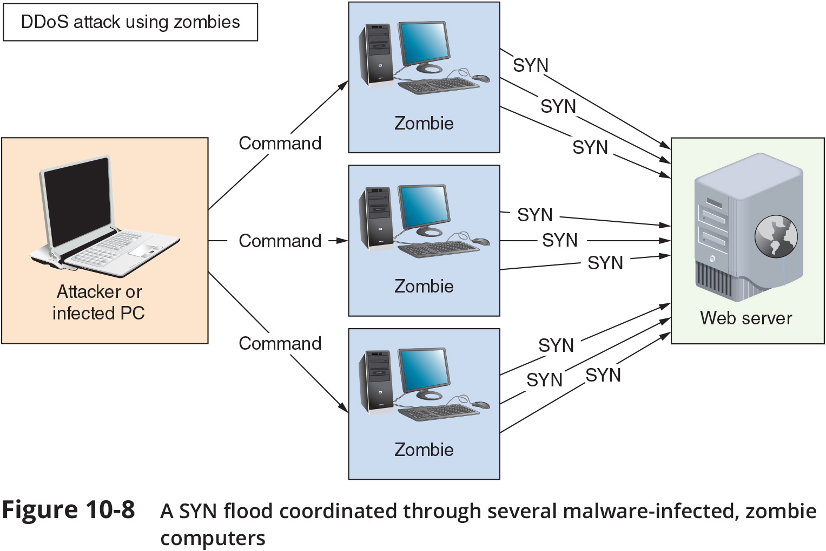
Technology Risks (3 of 4)

Slide 10
Technology Risks (4 of 4)
Other technology risks are related to weaknesses of wireless transmissions, authentication vulnerabilities, lack of encryption, or flaws in software design
Other types of attacks and vulnerabilities include the following:
On-path attack – relies on intercepted transmissions and can take several forms (previously called a MitM (man-in-the-middle) attack)
Deauth (deauthentication) attack – the attacker sends faked deauthentication frames to the AP, the client, or both, to trigger the deauthentication process and knock one or more clients off the wireless network

Slide 11
Technology Risks (4 of 4)
Insecure protocols and services – certain TCP/IP protocols are inherently insecure
DNS poisoning (DNS spoofing) – by altering DNS records on a DNS server, an attacker can redirect Internet traffic from a legitimate to a phishing website
Back doors – security flaws that allow unauthorised users to gain access to the system

Slide 12
Malware Risks (1 of 3)
Malicious software refers to any program designed to intrude upon or harm system, resources
Examples include viruses, Trojan horses, worms, bots, and ransomware

Slide 13
Malware Risks (1 of 3)
Malware is a generalised term that refers to many kinds of malicious software, as described in the following list:
Virus – a program that replicates itself with the intent to infect more computers
Trojan horse (Trojan) – a program that disguises itself as something useful, but actually harms your system
Worm – a programs that runs independently and travels between computers and across networks
Bot – a program that runs automatically without requiring a person to start or stop it
Ransomware – a program that locks a user’s data or computer system until a ransom is paid

Slide 14
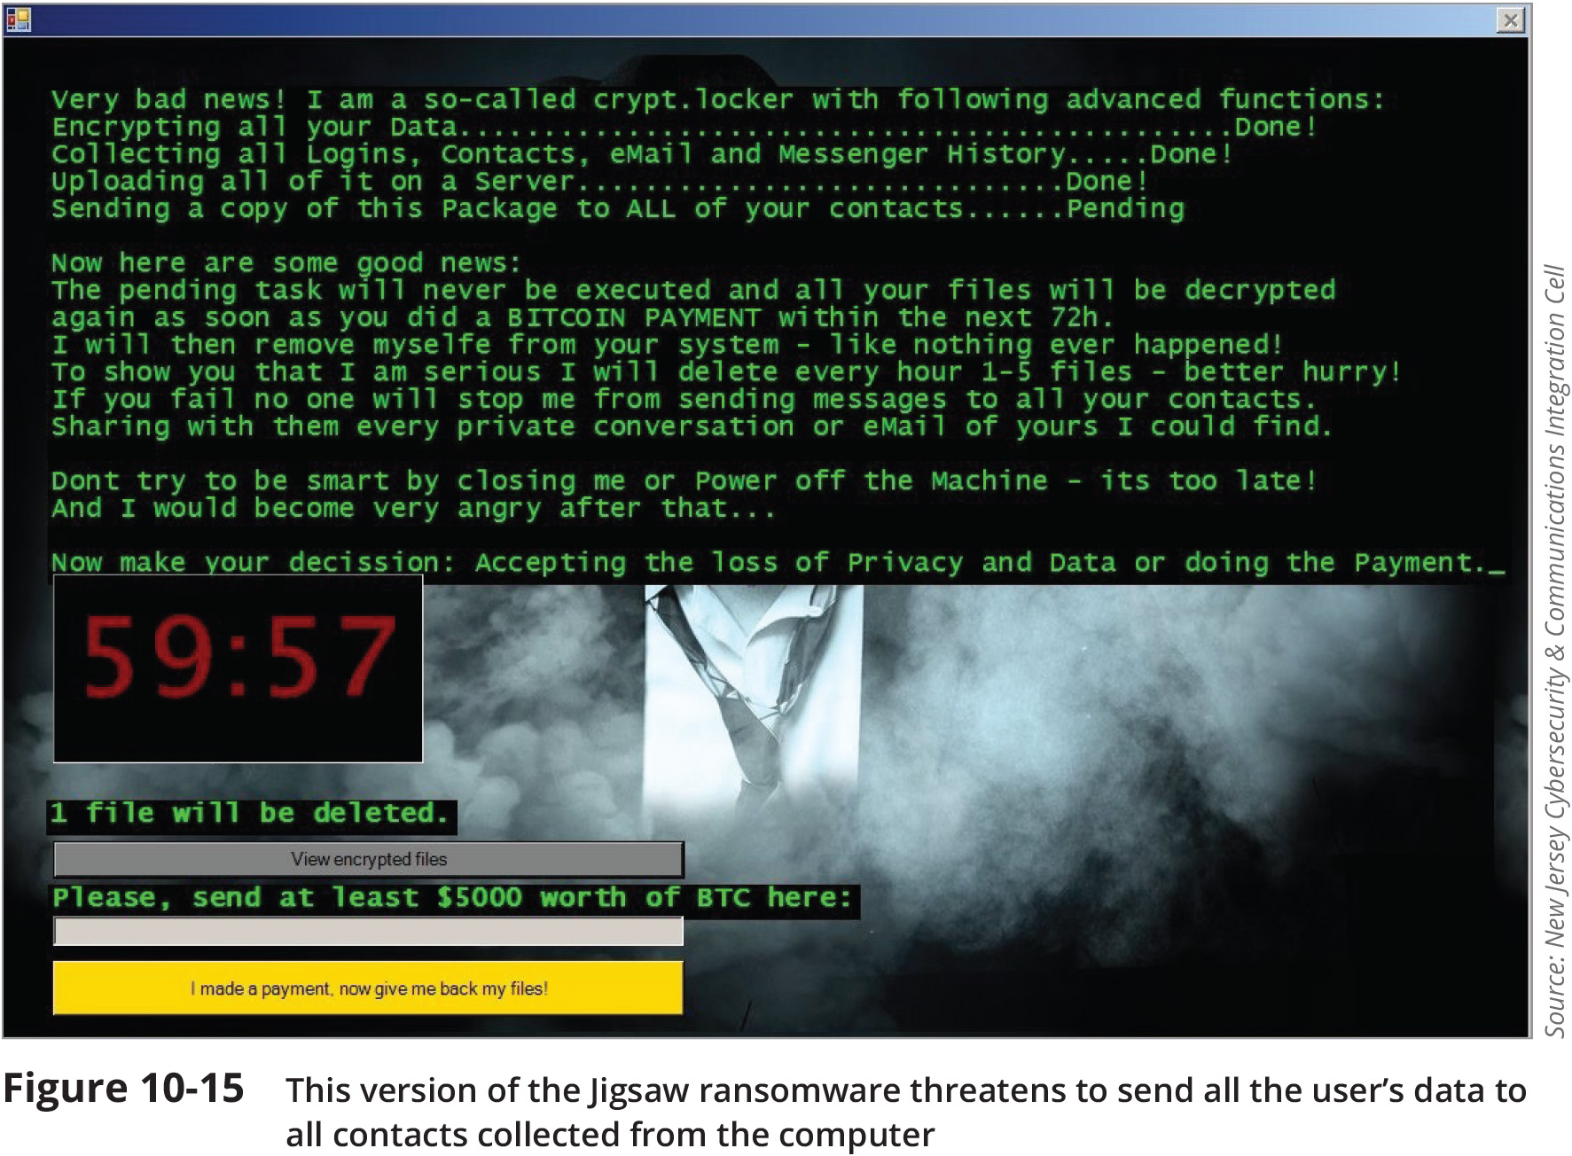
Malware Risks (2 of 3)

Slide 15
Malware Risks (3 of 3)
Malware characteristics include the following:
Encryption – some malware is encrypted to prevent detection
Stealth – some malware disguises itself as legitimate programs
Polymorphism – changes its characteristics every time it’s transferred to a new system
Time dependence – some malware is programmed to activate on a particular date
Logic bombs are programs designed to start when certain conditions are met
Malware can exhibit more than one of the above characteristics

